Slide 1
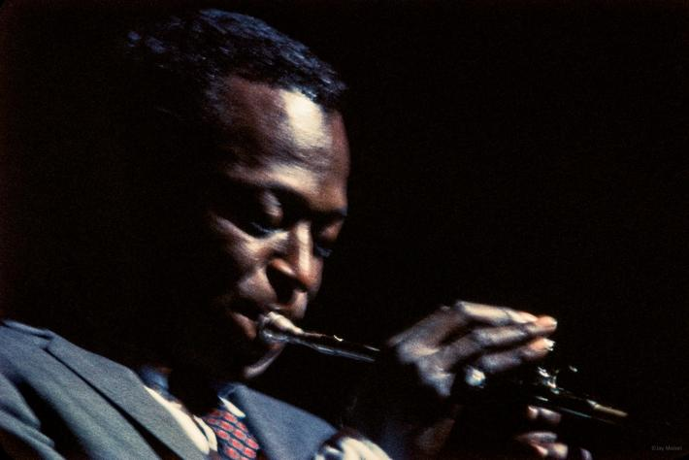
PROGETTO “DATAJAZZ”
Schembri Matteo Jacopo
1000012121
26/03/2021

Slide 2
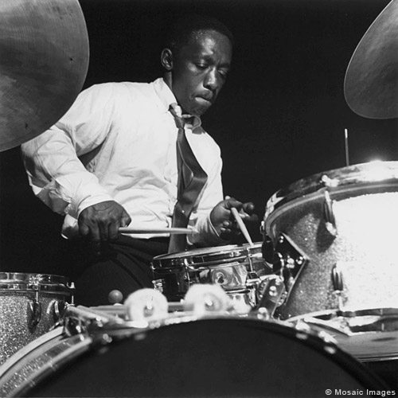
PRESENTAZIONE DEL PROGETTO
Si vuole realizzare un dominio che offra un servizio di download di trascrizioni di assoli presenti in brani jazz, come spiegato in dettaglio nel database.

Slide 3
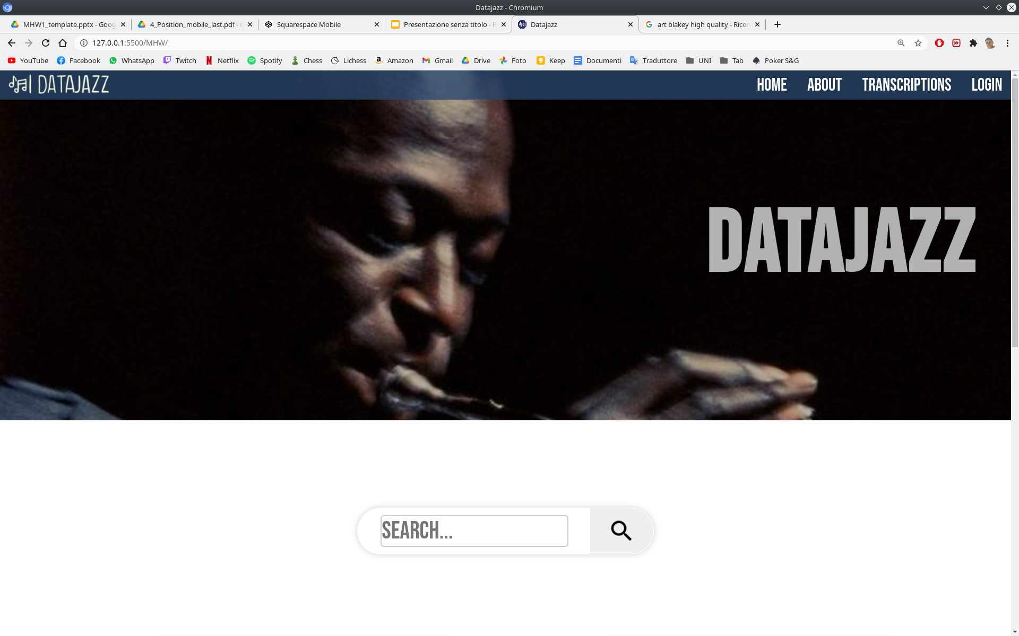
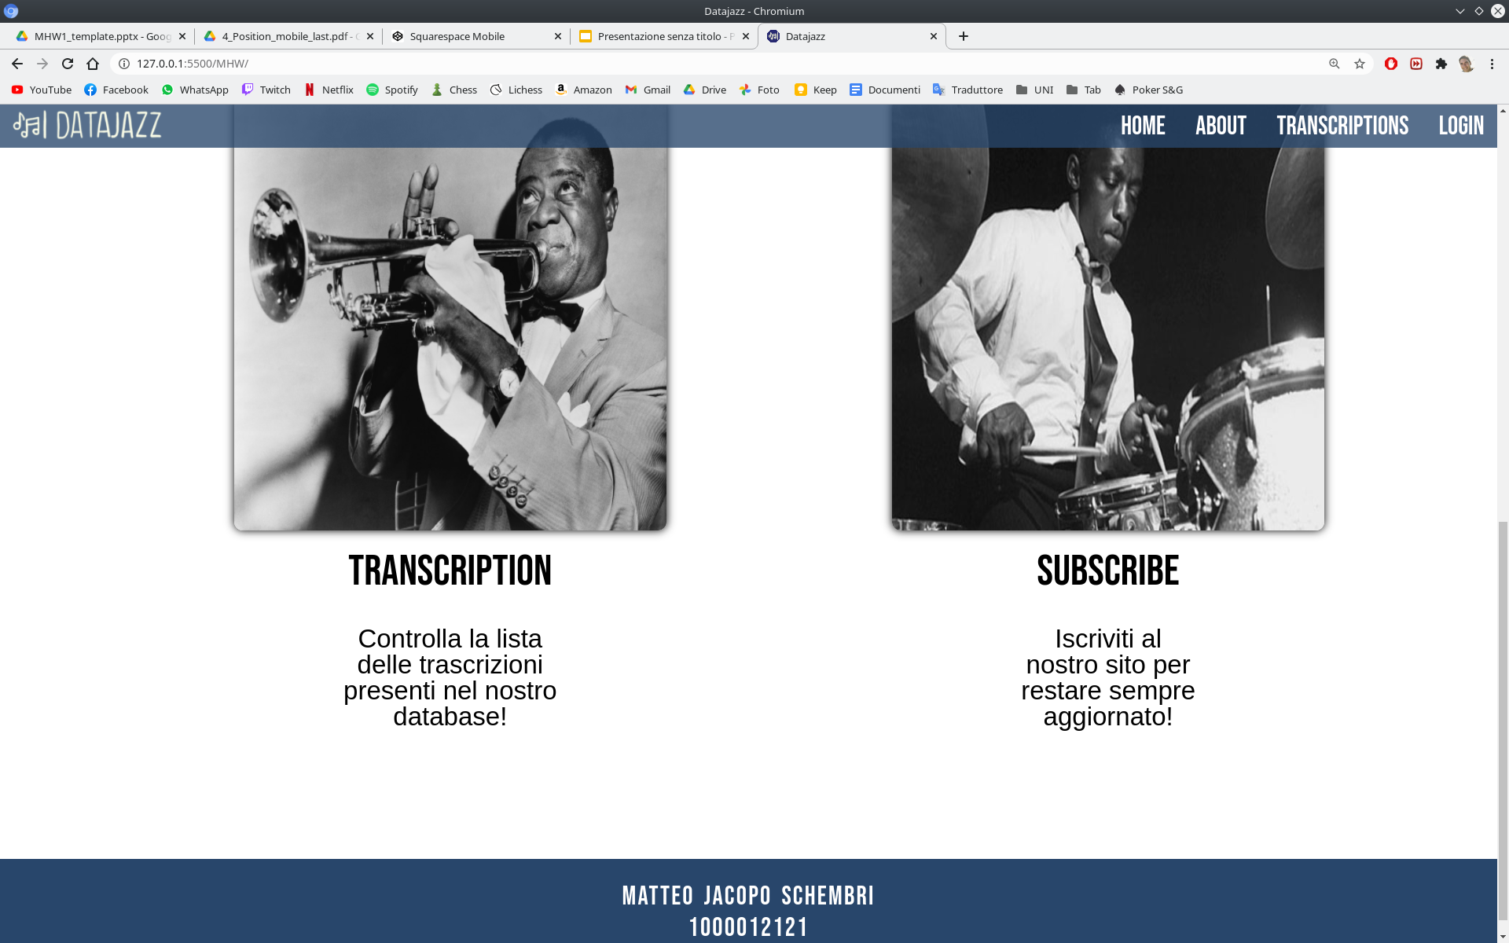
LAYOUT COMPLESSIVO

Slide 4

LAYOUT COMPLESSIVO
HTML
CSS
<!DOCTYPE html>
<html lang="en">
<head>
<link rel="stylesheet" href="style.css" />
<meta charset="UTF-8" />
<meta http-equiv="X-UA-Compatible" content="IE=edge" />
<meta name="viewport" content="width=device-width, initial-scale=1.0" />
<link rel="shortcut icon" href="/MHW/img/logopiccolissimo.png"/>
<title>Datajazz</title>
<link rel="preconnect" href="https://fonts.gstatic.com" />
<link href="https://fonts.googleapis.com/css2?family=Bebas+Neue&family=Chango&display=swap"
rel="stylesheet"
/>
<link
href="https://fonts.googleapis.com/css2?family=Open+Sans&display=swap"
rel="stylesheet"
/>
</head>
*{
box-sizing: border-box;
margin: 0px 0px;
padding: 0;
cursor: default;
font-family: "Bebas Neue", sans-serif;
}
a {
cursor: pointer;
text-decoration: none;
}
a:hover {
color: black;
}

Slide 5
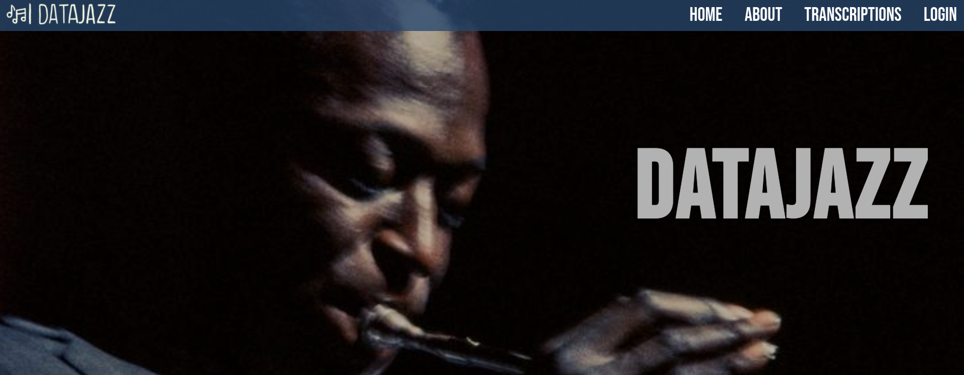
HEADER

Slide 6
HEADER
HTML
<header class="page-header">
<div>
<strong class="titolo">DATAJAZZ</strong>
</div>
<nav class="nav">
<img id="logo" src="img/logo.png"/>
<div id="links">
<a class = "nav-link">HOME</a>
<a class = "nav-link">ABOUT</a>
<a class = "nav-link">TRANSCRIPTIONS</a>
<a class = "nav-link">LOGIN</a>
</div>
<div id="menu">
<div></div>
<div></div>
<div></div>
<div></div>
</div>
</nav>
</header>

Slide 7
.titolo {
color: white;
font-size: 150px;
letter-spacing: 4px;
margin-right: 60px;
}
header::before {
content: ' ';
position: absolute;
top: 0;
left: 0;
bottom: 0;
right: 0;
background-color: rgba(0, 0, 0, 0.3);
}
CSS
header {
background-image: url(./img/miles.jpg);
background-size: cover;
background-position: center;
background-repeat: no-repeat;
height: 600px;
position: relative;
display: flex;
flex-direction: column;
align-items: flex-end;
justify-content: center;
}

Slide 8

MENU NAVIGAZIONE
HTML
CSS
<nav class="nav">
<img id="logo" src="img/logo.png"/>
<div id="links">
<a class = "nav-link">HOME</a>
<a class = "nav-link">ABOUT</a>
<a class = "nav-link">TRANSCRIPTIONS</a>
<a class = "nav-link">LOGIN</a>
</div>
<div id="menu">
<div></div>
<div></div>
<div></div>
<div></div>
</div>
</nav>
</header>
.nav {
background-color: #28466bc7;
position: fixed;
color: white;
display: flex;
padding: none;
top: 0;
left: 0;
right: 0;
font-size:30px;
justify-content: space-between;
align-items: center;
}
#logo {
height: 50px;
width: 200px;
}

Slide 9

#links a {
margin: 15px;
}
#menu {
display: none;
margin-right: 12px;
}
#menu div
{
width: 40px;
height: 2px;
background-color: rgb(255, 255, 255);
margin:8px 2px;
}
a:hover {
color: black;
}

Slide 10
SEZIONE CONTENUTI
HTML
<div class="contenuti">
<div id="b1">
<img src="img/lat.jpg" />
<button class="link-button">Transcription</button>
<p>Controlla la lista delle trascrizioni presenti nel nostro database!</p>
</div>
<div id="b2">
<img src="img/abd.jpg" />
<button class="link-button">Subscribe</button>
<p>Iscriviti al nostro sito per restare sempre aggiornato!</p>
</div>
</div>
</section>
<section>
<div id="ricerca">
<div id="container">
<label id="ins" for="search">
<input type="text" id="search" name="search"
placeholder="Search...">
</label>
<button id="search_button">
<img src="img/icon/search-icon.png" alt="cerca">
</button>
</div>
</div>

Slide 11
CSS
#ins {
font-size: 50px;
line-height: 50px;
color: #aaa;
flex-basis: 80%;
width: 100%;
}
input[type=text] {
width: 90%;
display: flex;
border: 2px solid #ccc;
border-radius: 6px;
font-size: 42px;
}
input[type=text]:focus {
background-color: #28466b52;
}
#ricerca {
padding: 150px 0 150px 0;
}
#container {
height: 80px;
box-sizing: border-box;
box-shadow: 0 0 10px #cecece;
max-width: 640px;
background: white;
justify-content: flex-start;
display: flex;
padding-left: 40px;
align-items: center;
line-height: 24px;
border-radius: 100px;
flex-basis: 100%;
}

Slide 12


#search_button {
padding: inherit;
height: 100%;
align-items: center;
padding: 30px;
font-size: 30px;
display: flex;
flex-grow: 1;
border-radius: 0 60px 60px 0;
justify-content: center;
border: 1px solid #fff;
cursor: pointer;
}
#search_button:hover {
background: #28466bc7;
color: white;
}
#search_button:focus {
outline: none;
}

Slide 13
.contenuti {
margin: 0 auto;
display: flex;
align-content: center;
justify-content: space-between;
font-size: 50px;
}
.link-button {
margin: 0 auto;
background-color: white;
color:black;
border: 2px solid rgb(255, 255, 255);
border-radius: 100px;
display: flex;
align-items: center;
justify-content: space-around;
font-size: 50px;
padding: 0 20px 0 20px;
}
.link-button:hover {
background: #28466bc7;
}
.link-button:focus {
outline: none;
}
.contenuti img {
height: 500px;
width: 500px;
box-shadow: 0 0 10px #000000;
border-radius: 10px;
}
.contenuti h1 {
text-align: center;
font-size: 45px;
text-transform: uppercase;
}
.contenuti p {
padding-top: 30px;
width: 30%;
color: black;
font-size: 30px;
line-height: 30px;
margin: auto;
font-family: Verdana, sans-serif;
}

Slide 14
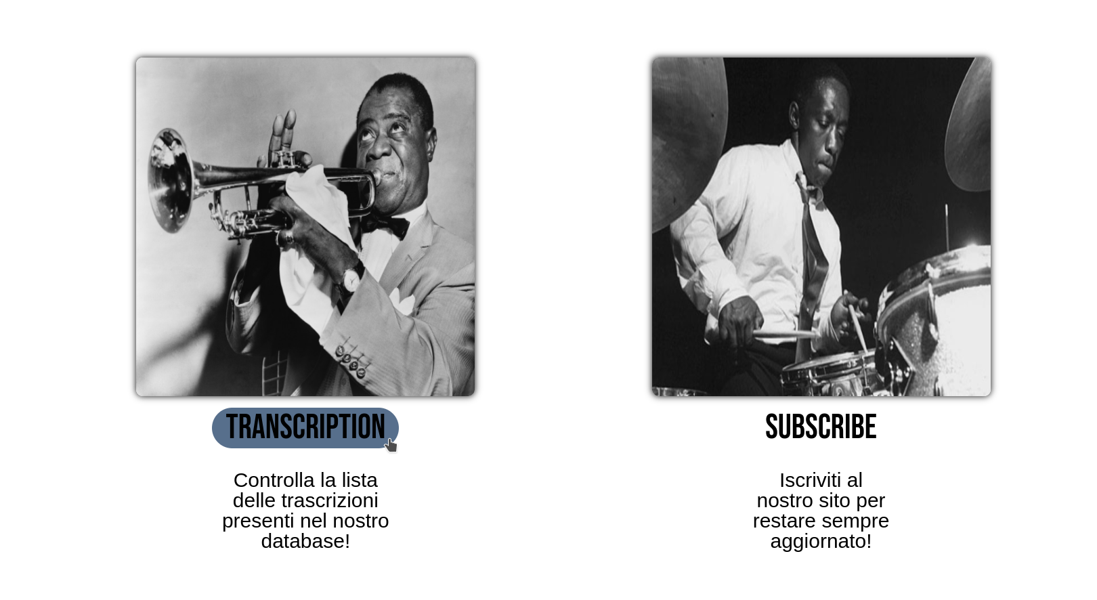

Slide 15

FOOTER
HTML
CSS
<footer>
<div>Matteo Jacopo Schembri</div>
<div>1000012121</div>
</footer>
footer {
background-color: #28466B;
padding: 25px;
text-align: center;
color: white;
font-size: 30px;
letter-spacing: 2px;
word-spacing: 4px;
}

Slide 16
MOBILE
@media (max-width: 750px) {
header {
display: flex;
width: 100%;
align-items: center;
}
header h1 strong {
font-size: 0.3em;
letter-spacing: 2px;
}
#logo {
font-size: 1em;
}
.nav-link {
display: none;
}
#menu {
display: block;
}
.titolo {
font-size: 125px;
top: 30%;
margin-right: 0px;
}
#ricerca{
padding-left: 2em;
padding-right: 2em;
}
.contenuti {
padding: 0 20px 0 20px;
flex-direction: column;
font-size: 0.5em;
padding-top: 3em;
padding-bottom: 1em;
}
.contenuti img {
width: 100%;
height:auto;
}
.link-button {
font-size: 40px;
margin-top: 2em;
}
.contenuti p {
text-align: center;
color: black;
font-size: 20px;
}
#b2 {
padding-top: 9em;
}
footer {
padding: 10px;
font-size: 2em;
}
}

Slide 17
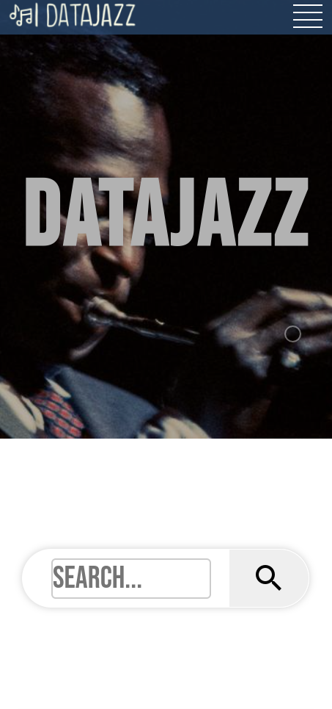
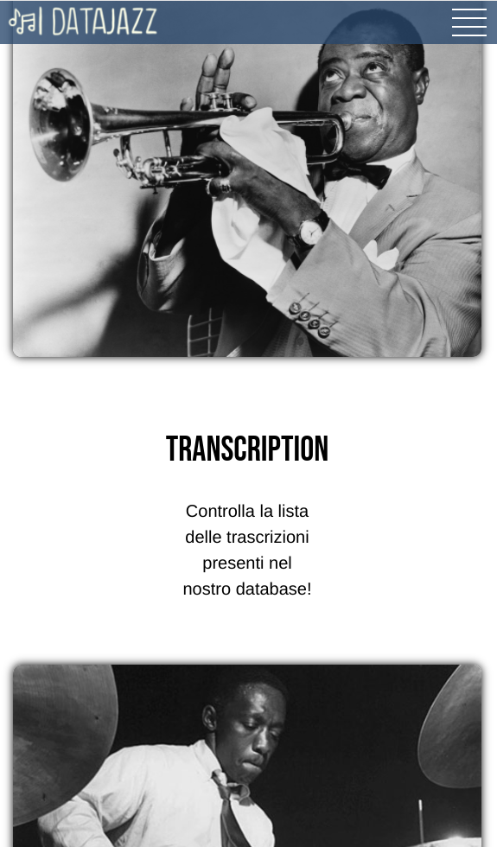
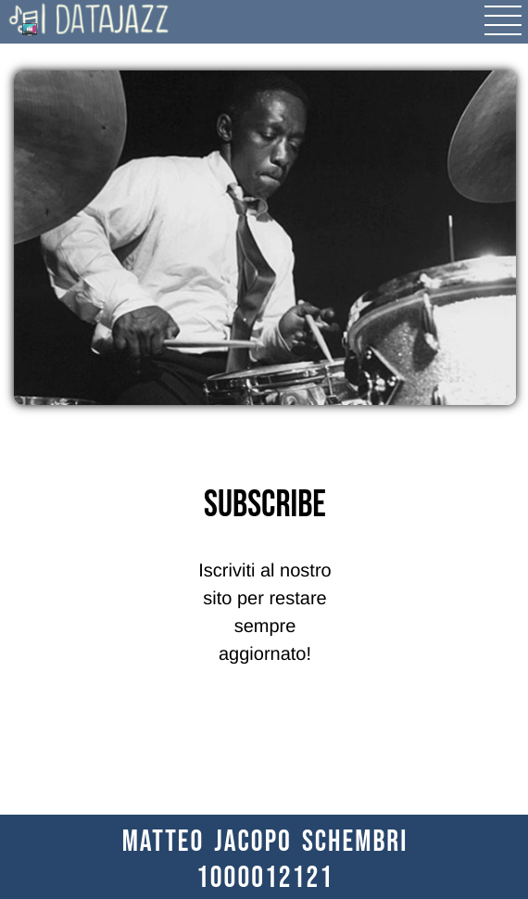

Slide 18
Grazie per l’attenzione
Schembri Matteo Jacopo
Kind of Blue recording session 1958 Kind of Blue © Jay Maisel

